Slide 1

NIDA Cocaine Collaborative Trial
Rashmi Kalra
STA 513

Slide 2
Agenda
Introduction
Data Understanding
Model Development
Model Results
Conclusions

Slide 3

1. Introduction
Problem Statement
National Institute of drug Abuse want to examine the efficacy of four psychosocial treatments (1=IDC, 2=CT, 3=SE, 4=GDC) for cocaine dependent patients on treating the Hamilton depression (SIGHD-17) at month three as well as the Month six of the treatment.
In addition to this, they want to examine the two way and three-way interaction hypothesis per time point . The company wants identify the factors that significantly influence the Hamilton depression Score . The major variables to consider are Gender, Race, Marital Status, Job, education status , Employment status and so on.
The other things to look at:
How the results differ from month three to the month 6 of the treatment.

Slide 4

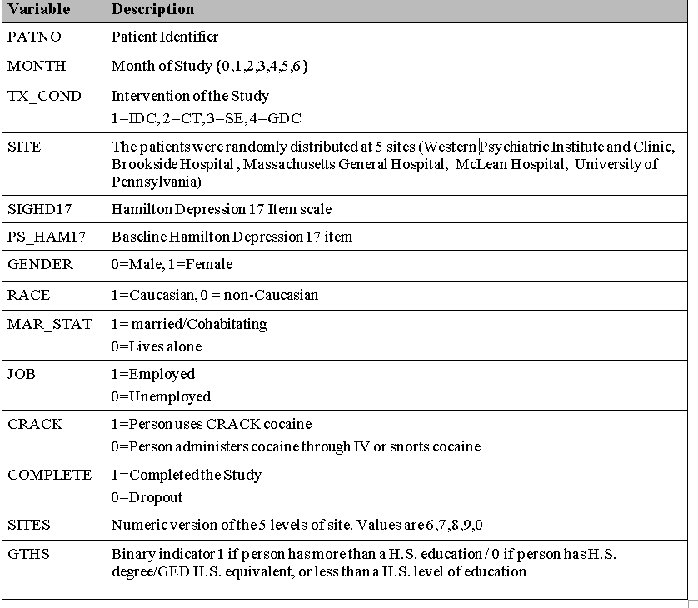
2. Data Understanding
To achieve the target, 487 patients were randomly assigned to the four treatments at five sites. The patients were assessed during the active treatment (1-6 month) after the baseline. The primary outcome is SIGHD-17(Hamilton Depression 17 Item Scale).
The data set used consists of 2697 observations and 76 variables. Of the 2697 observations there are 350 observations in the third month and 378 in sixth month sample. The analysis were carried out separately for the two time periods. A comparison has been carried out to study the effects at two time points.
Target Variable
Potential Covariate
Other categorical Variables

Slide 5
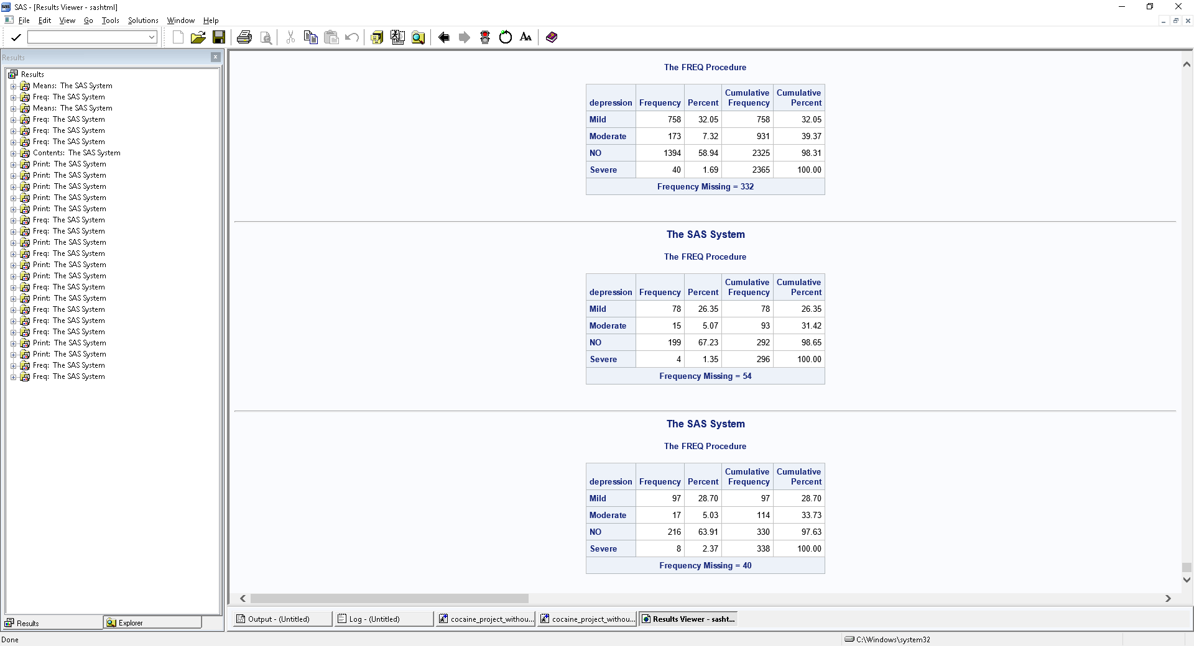
2. Data Understanding Cont.…
Outcome Variable (SIGHD17 : Hamilton Depression 17 item Scale) :
The patients are identified, and the depression level in the patients is measured on either a 3- or 5-point scale based on several components like Depressed mood, feeling of guilt, Suicide, Insomnia etc. Each summed to obtain the total score and the results of reading during the following ranges will tell the story of depression in the patient.
Interpretation: Higher the score, Higher the depression
Potential Covariate (PS_HAM17: Baseline Hamilton Depression 17 item Scale)
Covariate is any continuous variable, which is usually not controlled during data collection. This variable is the Hamilton depression score before the active phase of treatment(Month 0).
Also, we see that there are some missing values in the target
variable which should be treated(removed)before the analysis.
There were 54 missing values for the month three and 40 for the
month six.
0 7 8 16 17 23 24+
No Depression
Mild
Moderate
Severe

Slide 6
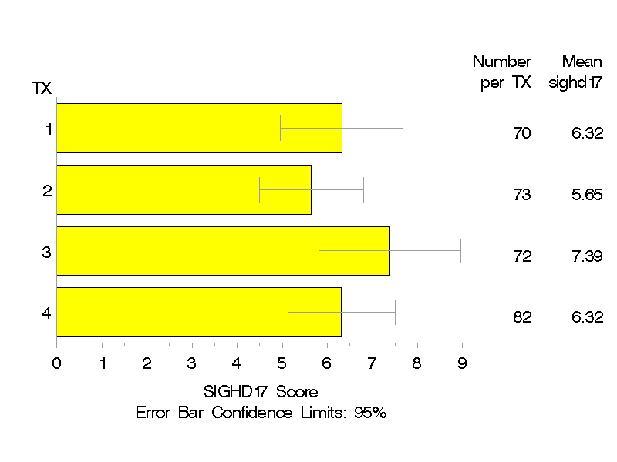
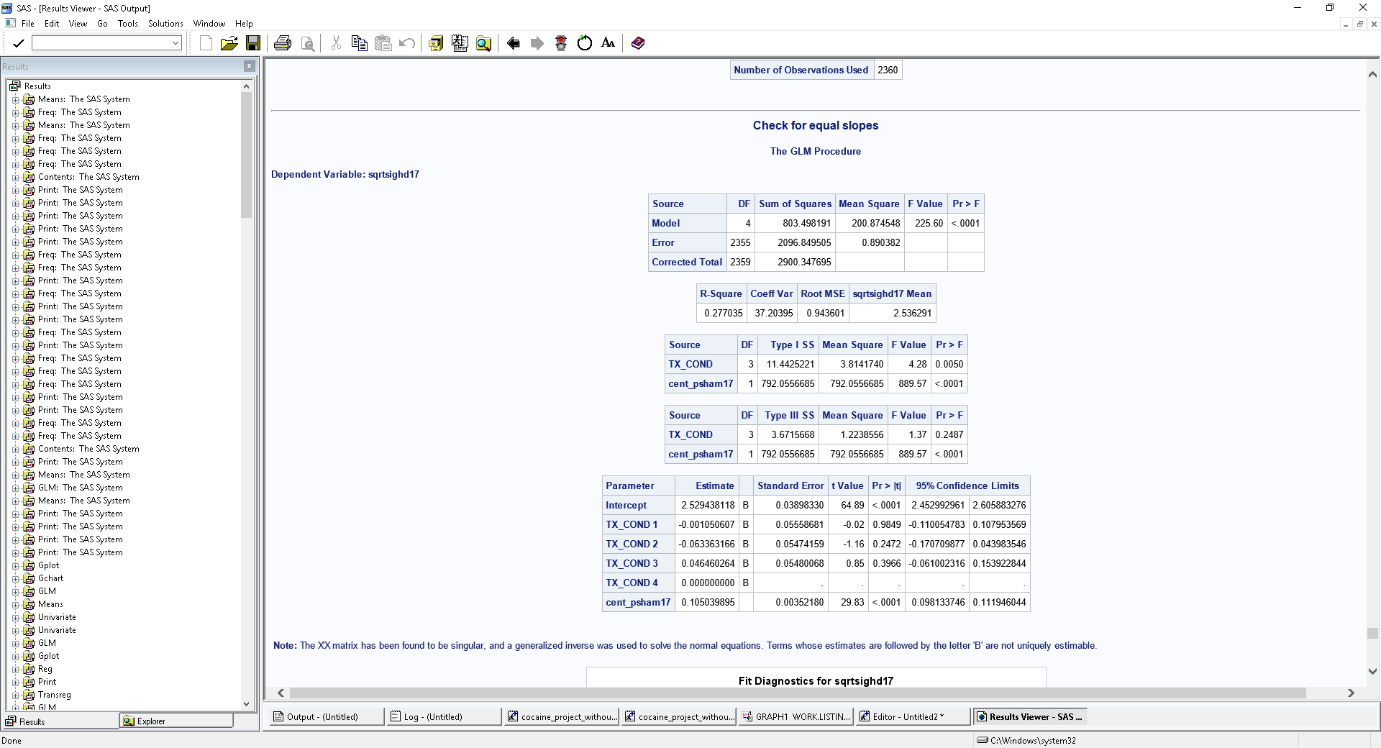
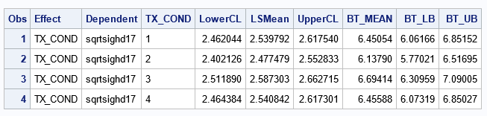
3. Model Development (Cross Sectional Analysis at Month 3)
The Treatment 3 has the highest average Hamilton depression score (SIGHD17) and Treatment 2 has the lowest (Graph1) and it appears to be significant without adjusting for covariate.
Prior to the efficacy analysis, we analyzed the Goodness of Fit assumptions. The Hamilton depression score had the highly skewed distribution, so a shifted square root transformation was performed.
CAUTION: Even after the Square root transformation the data was not normally distributed but we still performed the transformation because after transformation it very much better than then it was before.
We have included the Covariate PS_HAM17 into our model. It satisfied the consistency of slope assumption as the interaction between the covariate and the Treatment was not significant. Also, we see that MS error for this ANCOVA (0.89) is less that from the ANOVA (1.22) .Thus adding the covariate in the model improved the R-square value.
Upon running the ANCOVA model, we see that the p-value is 0.2487 which means that the four treatments are not significantly different from one another in treating the depression after adjusting for the Baseline Hamilton Depression Score.
Table 2 shows the Mean Hamilton depression score per treatment level even though there is no significant difference.
Graph1-Bar Plot
Table 1
Table 2-BackTransformed Mean

Slide 7
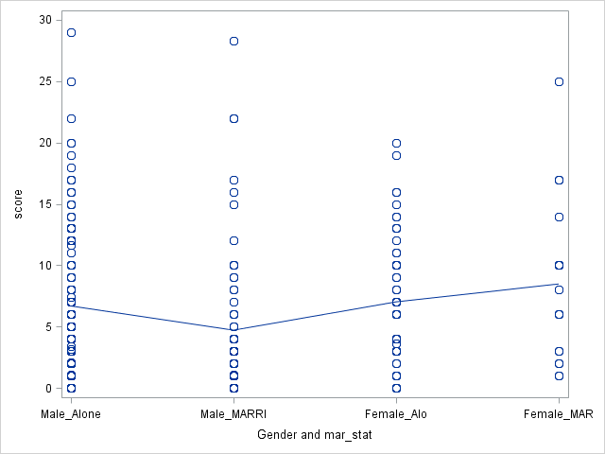
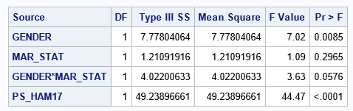
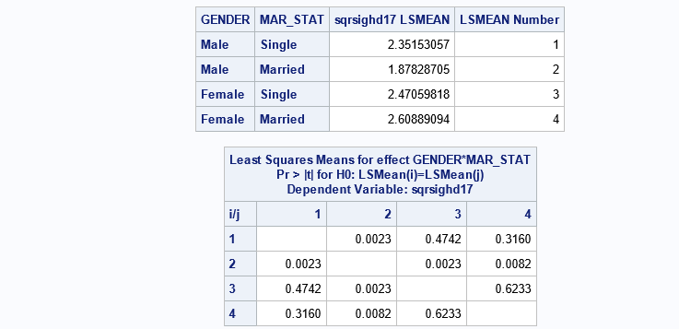
Sub hypothesis - Two Way Interaction (Cross Sectional Analysis at Month 3 Contd..)
Graph2-Graphical Depiction
Since the treatment effect was not significant so we removed that from the model and now we are interested in analyzing the two-way interaction for my a priori variables (Gender and Marital Status).
On eyeballing the graphs: It looks like the married/cohabiting male have the lowest Hamilton depression score and the Married/cohabiting Females have highest depression score (Graph2).
Output from ANCOVA:
The interaction between the gender and marital status is NOT significant which means that the on average difference in the SIGHD17 score for male and females DOES NOT vary differentially across different level of marital status (after controlling for covariate).
There is main effect due to the gender term. However, the Marital Status is not significant (Table 3).
Looking at the pairwise comparisons we see that the Married/Cohabiting Male are significantly different from the others (Table 4).They have the lowest depression score.
Table3
Table4-LSMEANS and the pairwise comparison

Slide 8
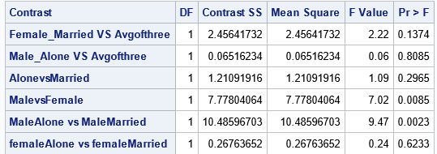
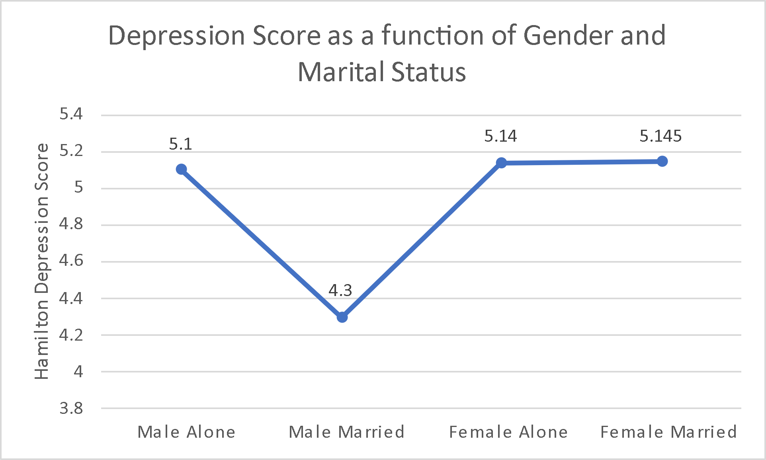
Sub hypothesis - Two Way Interaction (Cross Sectional Analysis at Month 3 Contd..)
Various contrasts are performed which concludes that:
Alone vs Married is not significant which means there is no main effect due to marital status.
Male vs Female is significant which means there is main effect due to the Gender.
Male Alone vs Male Married is significant which means being married appears to be associated with a lower risk of Hamilton depressive symptoms in men.
Female Alone vs Female Married is NOT significant which means there is no effect of marital status on depression for females.
Contrast between the Male Married compared to the average of other three (Male living alone, Female Single, Female Married) revealed that there is no significant difference among the Male married and the average of other three.
Contrast between the Female Married compared to the average of other three (Male Married, Male living alone, Female Single) revealed that Female married have more depression score compared to the average but that is not significant different.
Conclusion: “Marriage/Cohabiting means less chance of depression for men”.

Slide 9
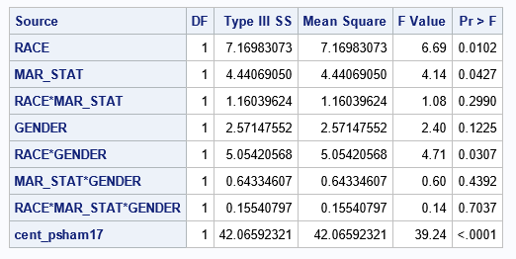
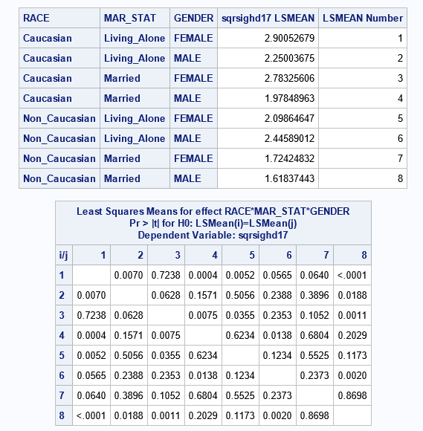
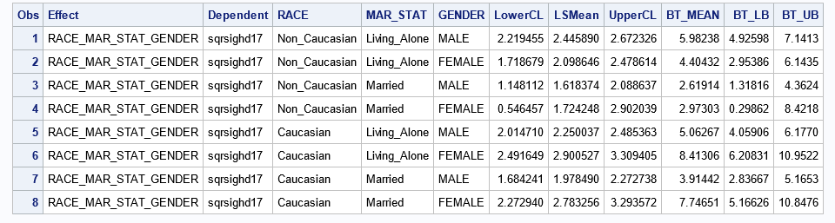
Sub hypothesis - Three Way Interaction (Cross Sectional Analysis at Month 3 Contd..)
We selected the Race variable a priori to include into the model. Now our model has Race, Marital Status and Gender variable.
The interaction between the Race , marital status and Gender is NOT significant(0.7037) which means on average difference in SIGHD17 score on the square root scale varying as a function of Gender (Male and female) over Marital status (married and living alone) does not varies differential across different level of RACE groups (after taking covariate into account). There is main effect due to the race and Marital Status . Also, the two-way interaction between race and gender is significant. (Table5)
Looking at the means values we see that the Caucasian Females who are living alone have the highest depression score followed by the Caucasian Married Females. They fall in the Mild Depression Zone.
Table5
Table 6- Mean score as well as the pair wise comparison with each categories on the square root scale .
Table 7 shows the back transformed mean Hamilton depression score.

Slide 10
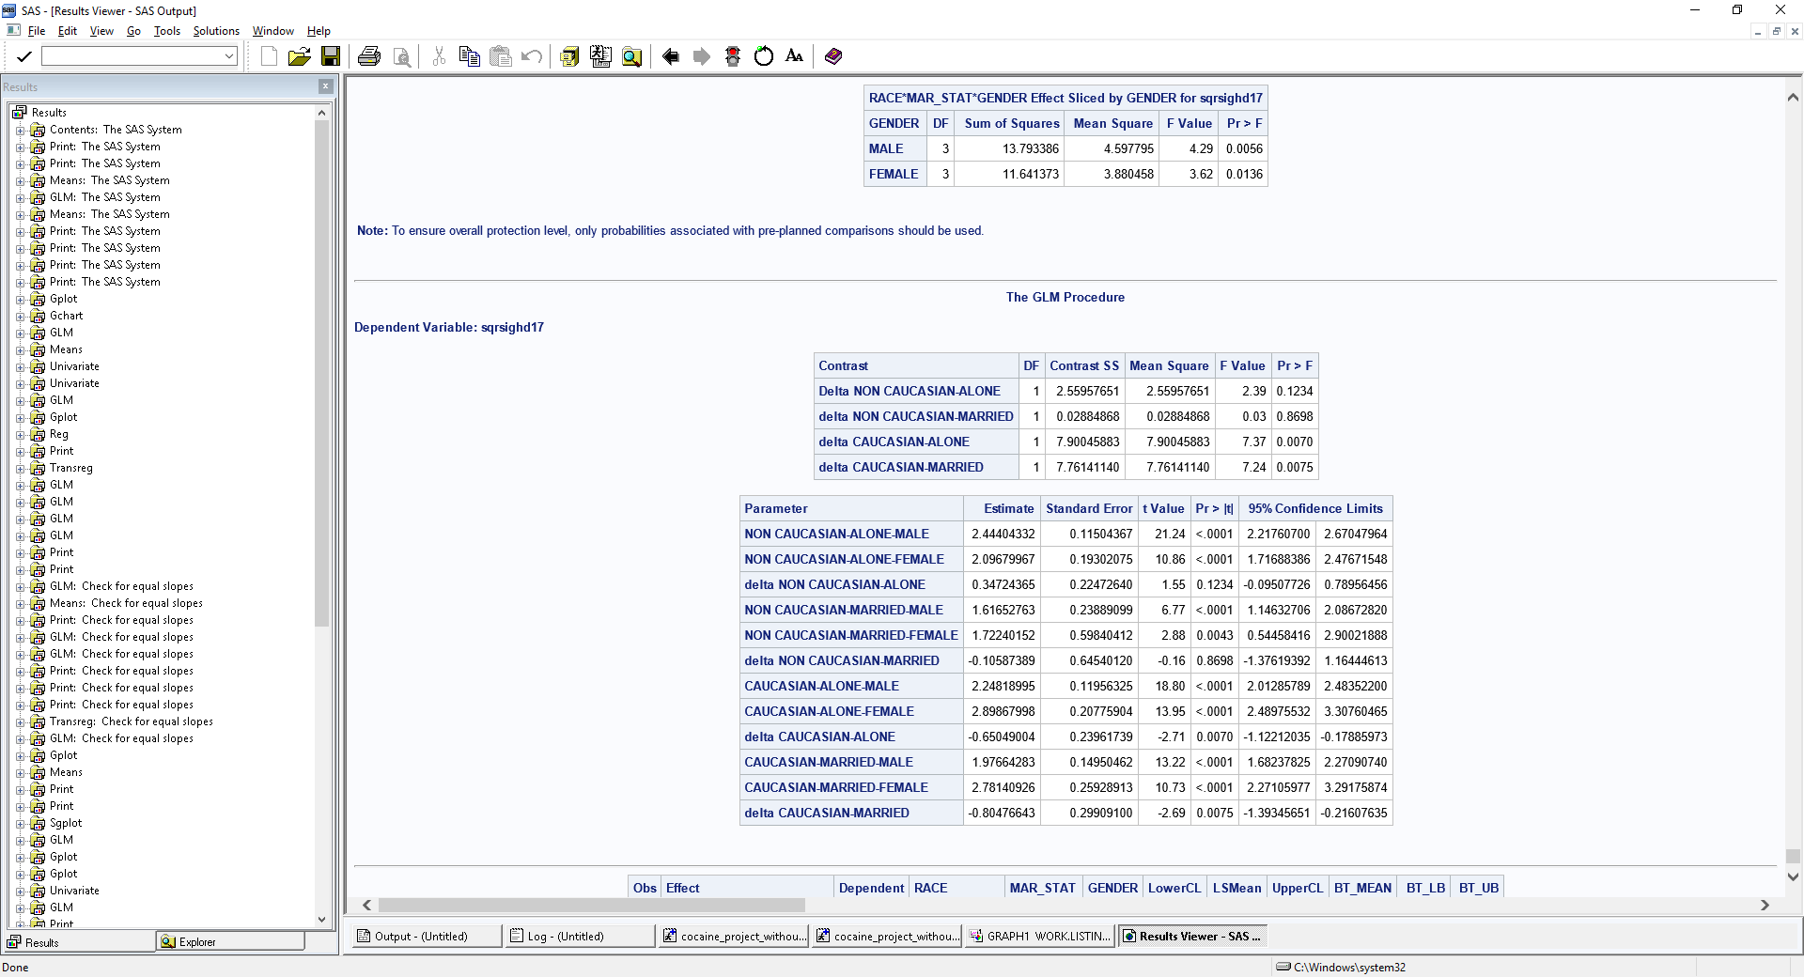
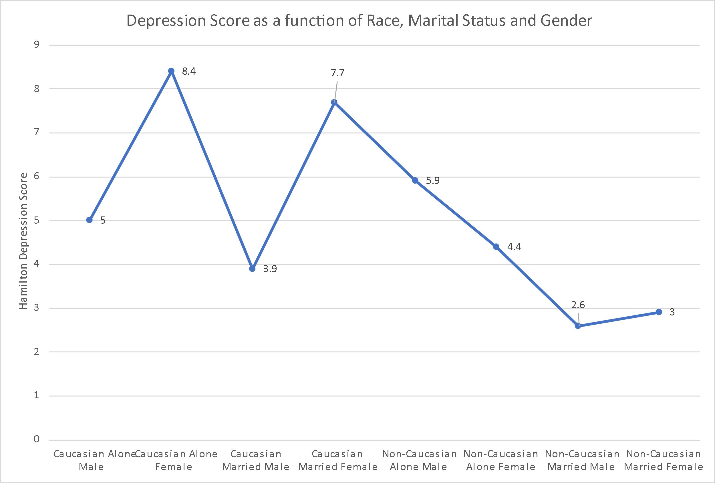
Sub hypothesis - Three Way Interaction (Cross Sectional Analysis at Month 3 Contd..)
Various contrasts are performed which concludes that:
Caucasian Living alone females have the highest depression score followed by the Caucasian married females.
Looking at he contrasts we see that, there is significant difference in the Hamilton Depression score between CAUCASIAN ALONE FEMALE and CAUCASIAN ALONE MALE with the females having more depression.
There is significant difference in the HD score between CAUCASIAN MARRIED FEMALE and CAUCASIAN MARRIED MALE with the females having more depression.
There is no significant difference in the male and female of Non- Caucasian Race.
Conclusion: “CAUCASIAN FEMALE has more depression score regardless of the marital status as compared to men”
Both Caucasian Female fall into the MILD Depression Zone.

Slide 11
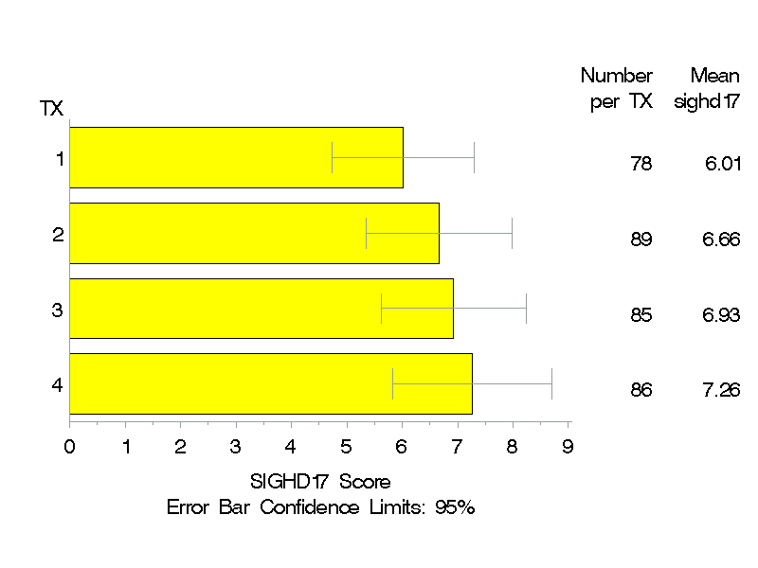
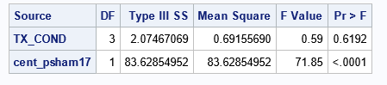
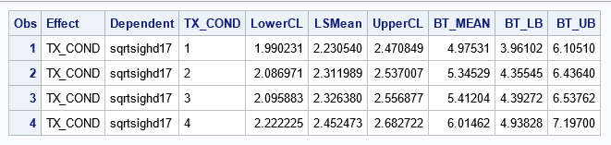
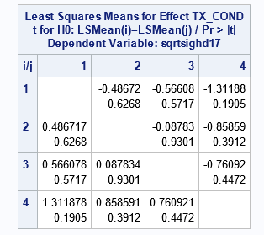
3. Model Development (Cross Sectional Analysis at Month 6)
Graph1
Looking at these graph 1, we can say that the treatment 1 has lowest mean Hamilton depression score as compared to others and treatment 4 has highest depression score.
Prior to the efficacy analysis, we analyzed the Goodness of Fit assumptions. For Cross sectional analysis at Month 6 the Hamilton depression score had the highly skewed distribution, so a shifted square root transformation was performed.
Note: Even after the transformation results are not Normal so proceed with caution
Upon running the ANCOVA model, we see that the p-value is 0.6192 which means that the four treatments are not significant different from one another in treating the depression after adjusting for the Baseline Hamilton Depression Score.
Table 2 shows the Mean Hamilton depression score per treatment level. We see that treatment 4 has highest depression score and treatment 1 has lowest but they are not significantly different.
Table 1
Table 2

Slide 12
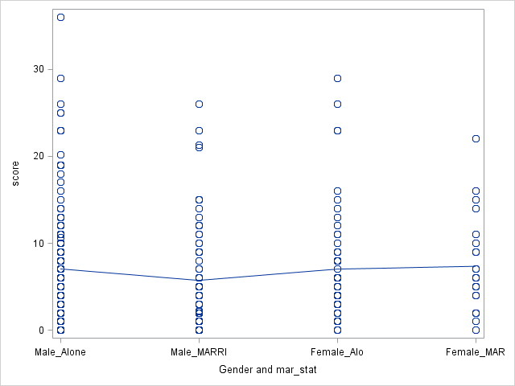
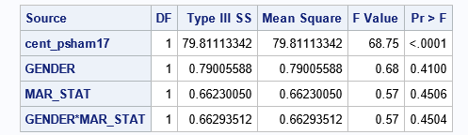
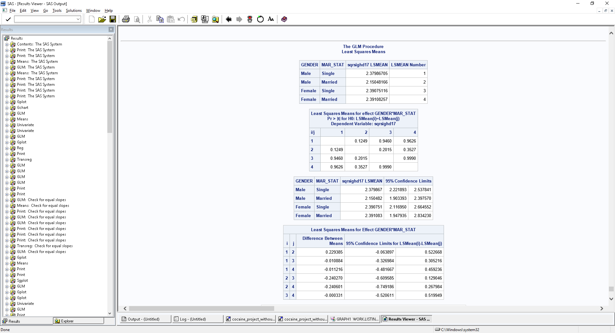
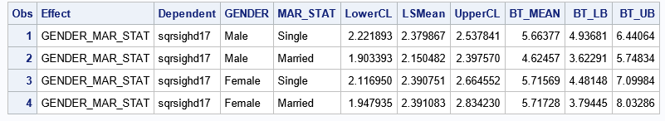
Sub hypothesis - Two Way Interaction (Cross Sectional Analysis at Month 6 Contd..)
Since the treatment effect was not significant so we removed that from the model and now we are interested in analyzing the two-way interaction for my a priori variables (Gender and Marital Status).
On eyeballing the graphs: It looks like the married/cohabiting male have the lowest Hamilton depression score and the Married/cohabiting Females have highest depression score (Graph2).
Output from ANCOVA:
The interaction between the gender and marital status is NOT significant which means that the on average difference in the SIGHD17 score for male and females DOES NOT vary differentially across different level of marital status (after controlling for covariate).
There is NO main effect due to the gender term and Marital Status (Table 3).
Looking at the pairwise comparisons(Table4) we see that there is NO significant difference IN ANY OF THE GROUP.
Graph2 showing that the Females who are married have highest depression score
Table3
Table4-Estimates on the Back transformed Scale

Slide 13
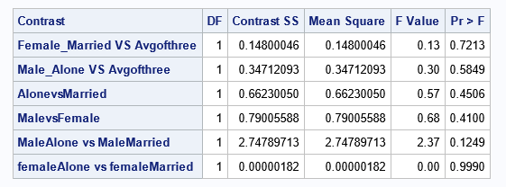
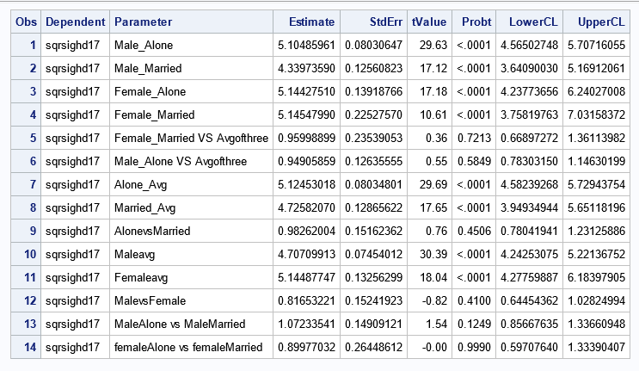
Sub hypothesis - Two Way Interaction (Cross Sectional Analysis at Month 6 Contd..)
Various contrasts are performed which concludes that:
None of the term is significant means that “male vs female” or “alone vs married” are not significantly different from one another at month 6.
We also checked the Female Alone vs Female Married and they are not significant different from one another.
Similarly, there was no significant difference among the Male Alone and Male Married.
We also performed contrasts like Female Married compared to the average of other three and Male Alone vs average of other three. There is no significant difference in any of them.
Conclusion: Being married appears to be associated with a lower risk of depressive symptoms in men at month 3 of treatment however there is no significant difference at the month 6.

Slide 14
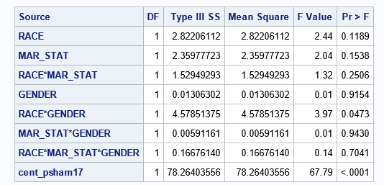
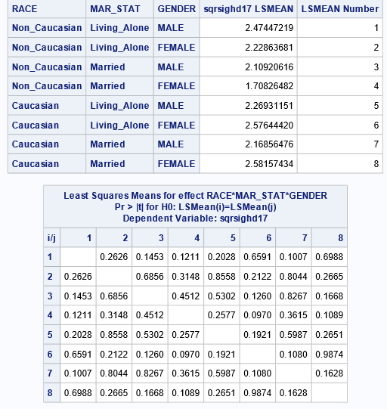
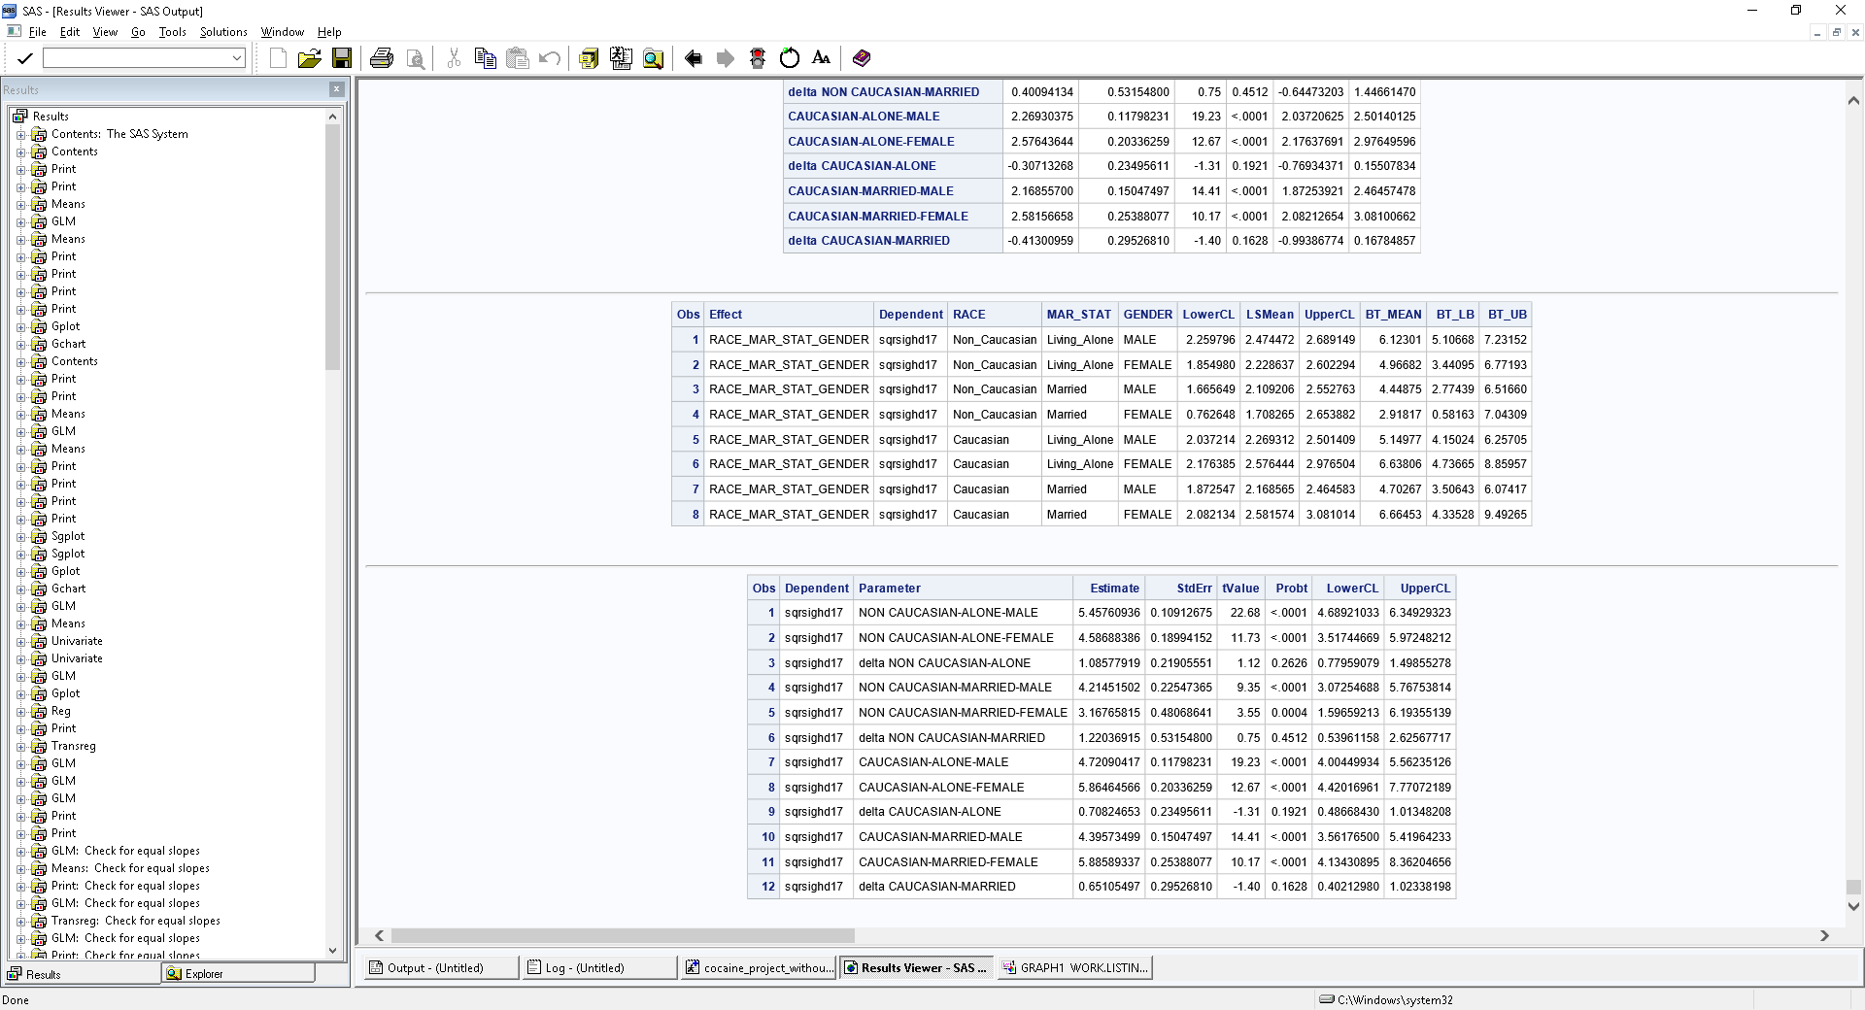
Sub hypothesis - Three Way Interaction (Cross Sectional Analysis at Month 6 Contd..)
We selected the Race variable a priori to include into the model. Now our model has Race, MAR_STAT and Gender variable.
Output from ANCOVA:
The interaction between the Race , marital status and Gender is NOT significant(0.7041) which means on average difference in SIGHD17 score on the square root scale varying as a function of Gender (Male and female) over Marital status (married and living alone) does not varies differential across different level of RACE groups (after taking covariate into account). (Table5)
The two-way interaction between race and gender is significant.
Looking at the Pairwise comparison. we see that the none of the groups are significant different from each other.
Table5
Table 6 shows the Mean score as well as the pair wise comparison with each categories on the square root scale
Table 7 -the back transformed mean Hamilton depression score.

Slide 15
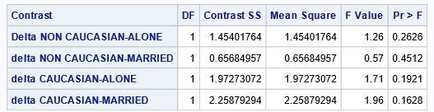
Sub hypothesis - Three Way Interaction (Cross Sectional Analysis at Month 6 Contd..)
Various contrasts are performed which concludes that:
There is NO significant difference in the male and female of the Non-Caucasian race and are living alone.
There is NO significant difference in the male and female of the Non-Caucasian race and are Married.
There is NO significant difference in the male and female of the Caucasian race and are living alone.
There is NO significant difference in the male and female of the Caucasian race and are Married.
Conclusion: None of the groups are significant different from one another.

Slide 16
Comparison between Month 3 and Month 6 of Treatment
 | Treatment Effects | Marital Status and Gender | Marital Status, Race and Gender
Month 3 | None of the Treatment effect is significant different from each other. | The two-way interaction between the gender and marital status is NOT significant . There is main effect due to the gender term. However, the Marital Status is not significant The Married/Cohabiting Male are significantly different from the others with the lowest depression score. | The interaction between the Race , marital status and Gender is NOT significant which means on average difference in SIGHD17 score on the square root scale varying as a function of Gender (Male and female) over Marital status (married and living alone) does not varies differential across different level of RACE groups . We see that the Caucasian Females who are living alone have the highest depression score followed by the Caucasian Married Females.
Month 6 | None of the Treatment effect is significant different from each other. | The interaction between the gender and marital status is NOT significant . There is NO main effect due to the gender term and Marital Status . None of the Pairwise comparison is significant different from one another. | The interaction between the Race , marital status and Gender is NOT significant . The Pairwise comparison is NOT significant different from one another.

